Slide 1
What is a UML class diagram?
A UML class diagram is a picture of the classes in an OO system
their fields and methods
connections between the classes that interact or inherit from each other
Not represented in a UML class diagram:
details of how the classes interact with each other
algorithmic details; how a particular behavior is implemented

Slide 2
Benefits of Class Diagram
Class Diagram Illustrates data models for even very complex information systems
It provides an overview of how the application is structured before studying the actual code. This can easily reduce the maintenance time
It helps for better understanding of general schematics of an application.
Allows drawing detailed charts which highlights code required to be programmed
Helpful for developers and other stakeholders.

Slide 3
Diagram of a single class
Class name on top
write «interface» on top of interfaces' names
use italics for an abstract class name
Student
Rectangle
<<interface>>
Shape
- name: String
- id: int
- totalStudents:int
- width: int
- height: int
/ area: double
# getID():int
~ getEmail():String
# Rectangle(w:int, h:int)
+ distance(r:Rectangle):double
+ calculateArea():double
Attributes (optional)
In the middle
Operations/ methods (optional)
may omit trivial (get/set) methods
but don't omit any methods from an interface!
should not include inherited methods

Slide 4
Class attributes (fields, instance variables)
visibility name : type [count] = default_value
Student
+ name: int
+ email: String
- DOB: String
/ Age: int
# dawgID: int
~ courses[100]:Course
Visibility
+ public
# protected
- private
~ package (default)
/ derived
underline static attributes
+ calculateTuition():double

Slide 5
Class operations / methods
visibility name(parameters) : return_type
Student
+ name: String
+ email: String
- DOB: String
/ Age: int
# dawgID: int
~ courses[100]:Course
Visibility
+ public
# protected
- private
~ package (default)
underline static methods
Parameters listed as name:type
Omit return_type on constructors and when return type is void
+Student(n:String,dob:String)
+ getTotalCredits():Course
# calculateTuition():double
+ calculateGPA(crs: Course[]):float

Slide 6
Relationships between class
Generalization: an inheritance relationship
inheritance between classes
interface implementation
Association: a usage relationship
dependency
aggregation
composition

Slide 7
Generalization relationships
Hierarchies drawn top-down
Arrows point upward to parent
Line/arrow styles indicate if parent is a(n):
class: solid line, black arrow
interface: dashed line, white arrow
abstract class: solid line, white arrow
<<interface>>
Shape
+ calculateArea():double
RectangularShape
- width:int
- height: int
/ area: double
+ calculateArea():double
+ contains(x:int,y:int):bool
Rectangle
+ Rectangle(x:int,y:int)
+ distance(r:Rectangle):double

Slide 8
Association (usage) relationships
Multiplicity (how many are used)
* (zero or more)
1 (exactly one)
2..4 (between 2 and 4, inclusive)
3..* (3 or more, * may be omitted)
Class A
Class B
1…*
k
contains
Name (what relationship the objects have)
Navigability (direction)

Slide 9
Association multiplicities
One to one
Each car has exactly one engine
Each engine belongs to exactly one car
Engine
Car
1
1
One to many
Each book has many pages
Each page belongs to exactly one book
Page
Book
*
1

Slide 10
Association types
Aggregation: “is part of”
symbolized by a clear white diamond
Engine
Car
1
1
Composition: “is entirely made of”
stronger version of aggregation
the parts live and die with the whole
symbolized by a black diamond
Page
Book
*
1
Dependency: “uses temporarily”
symbolized by dotted line
often is an implementation detail, not an intrinsic part of the object's state
Lottery
Random

Slide 11
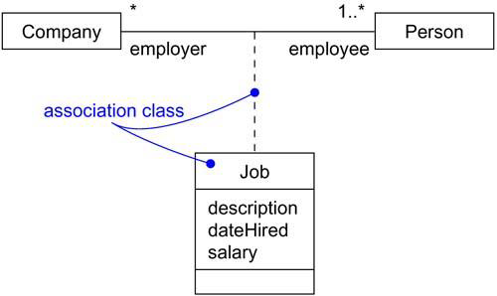
Association Class
In an association between two classes, the association itself might have properties.
For example, in an employer/employee relationship between a Company and a Person, there is a Job that represents the properties of that relationship that apply to exactly one pairing of the Person and Company.
It wouldn't be appropriate to model this situation with a Company to Job association together with a Job to Person association. That wouldn't tie a specific instance of the Job to the specific pairing of Company and Person.

Slide 12
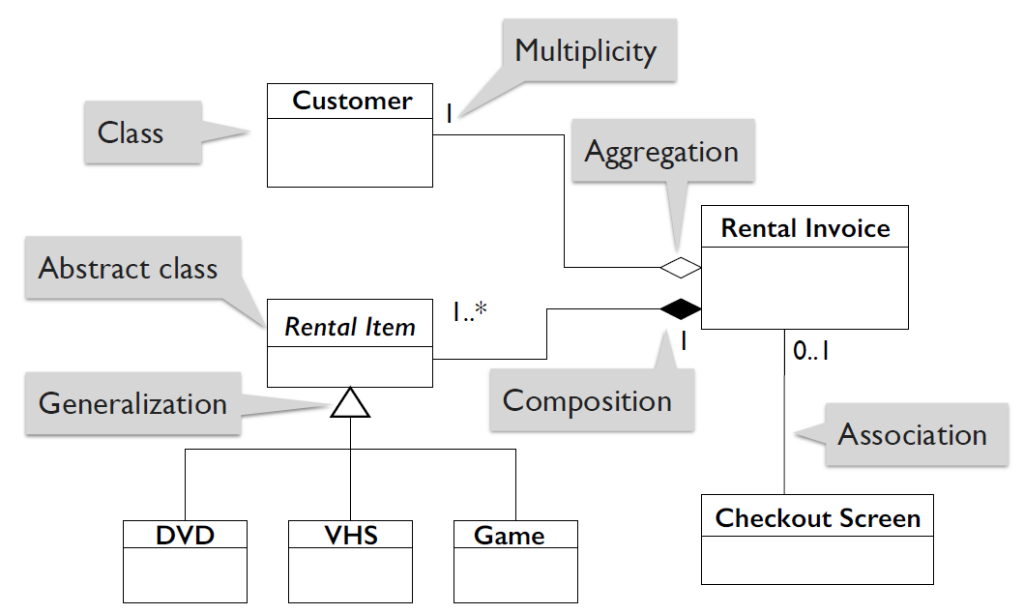
Example: Video rental store

Slide 13
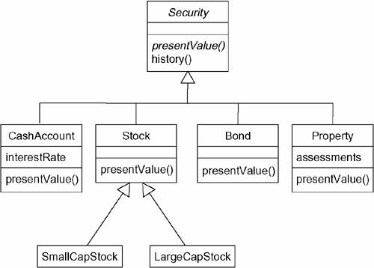
More Example of Inheritance

Slide 14
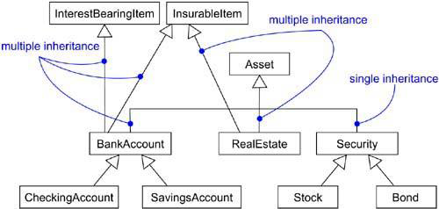
Multiple Inheritance

Slide 15
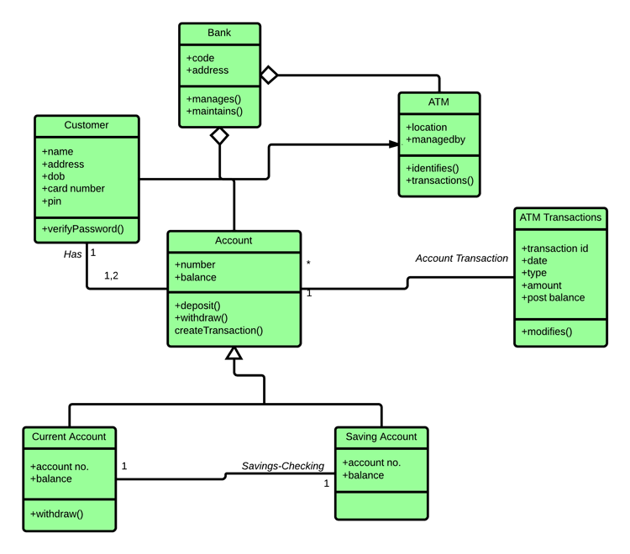

Slide 16
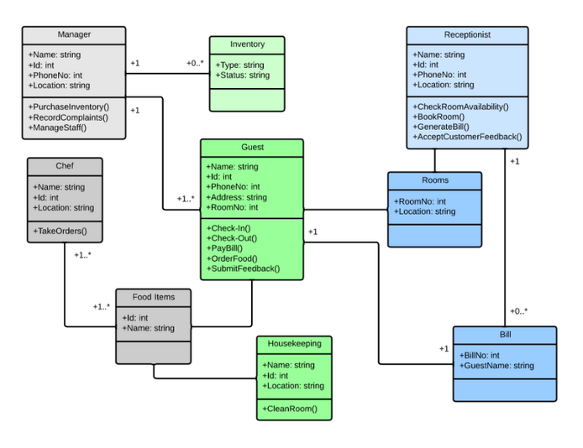

Slide 17
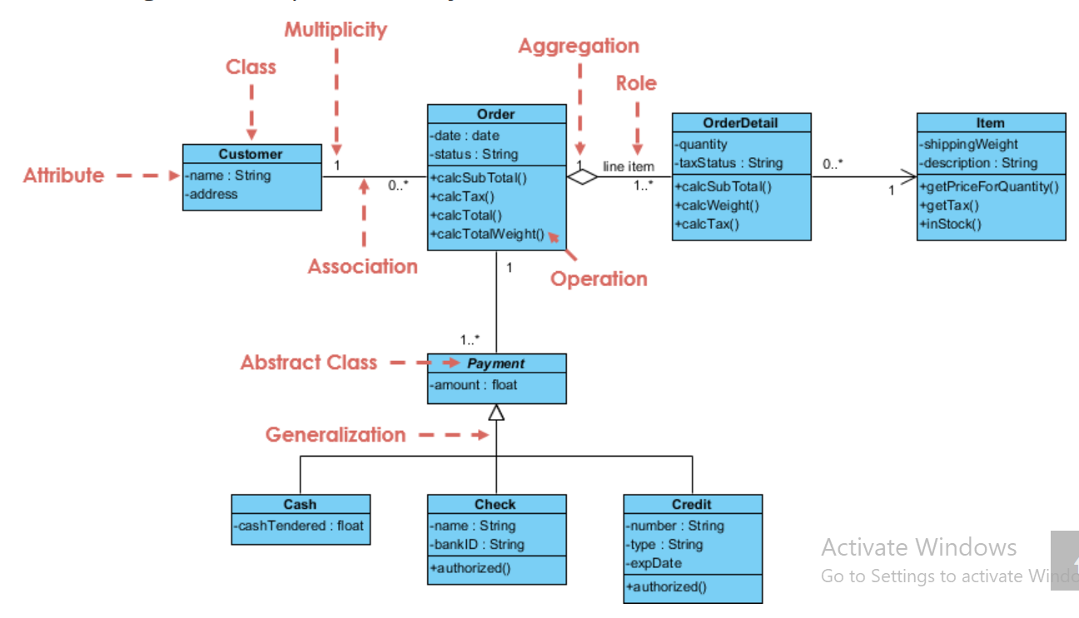

Slide 18
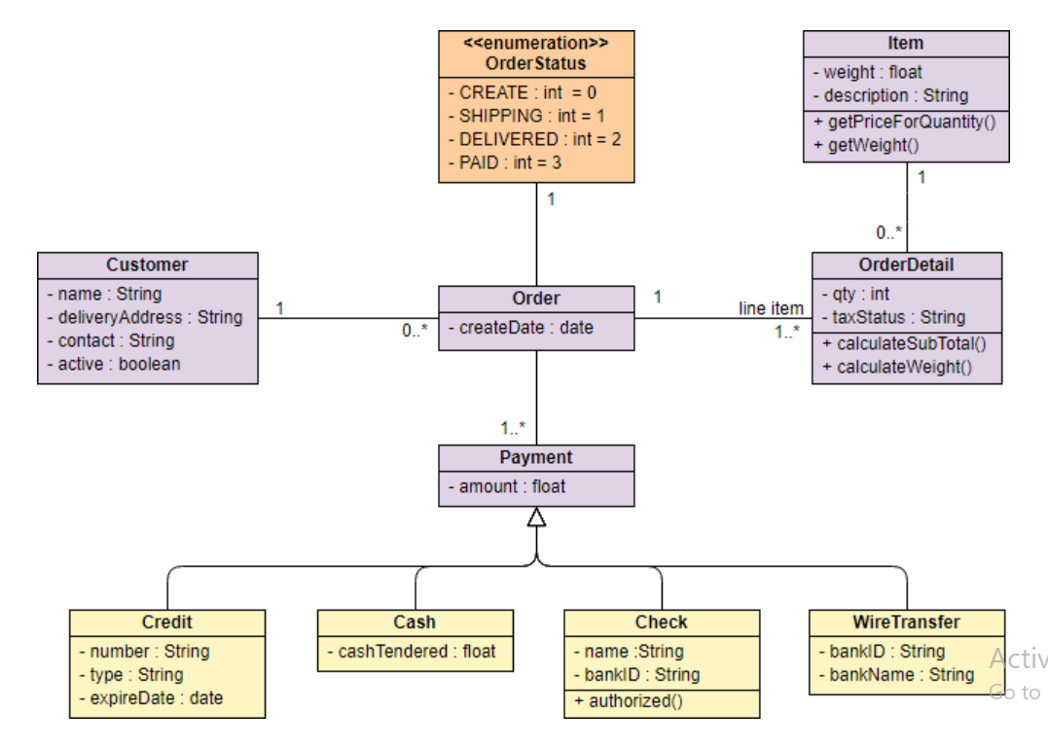

Slide 19
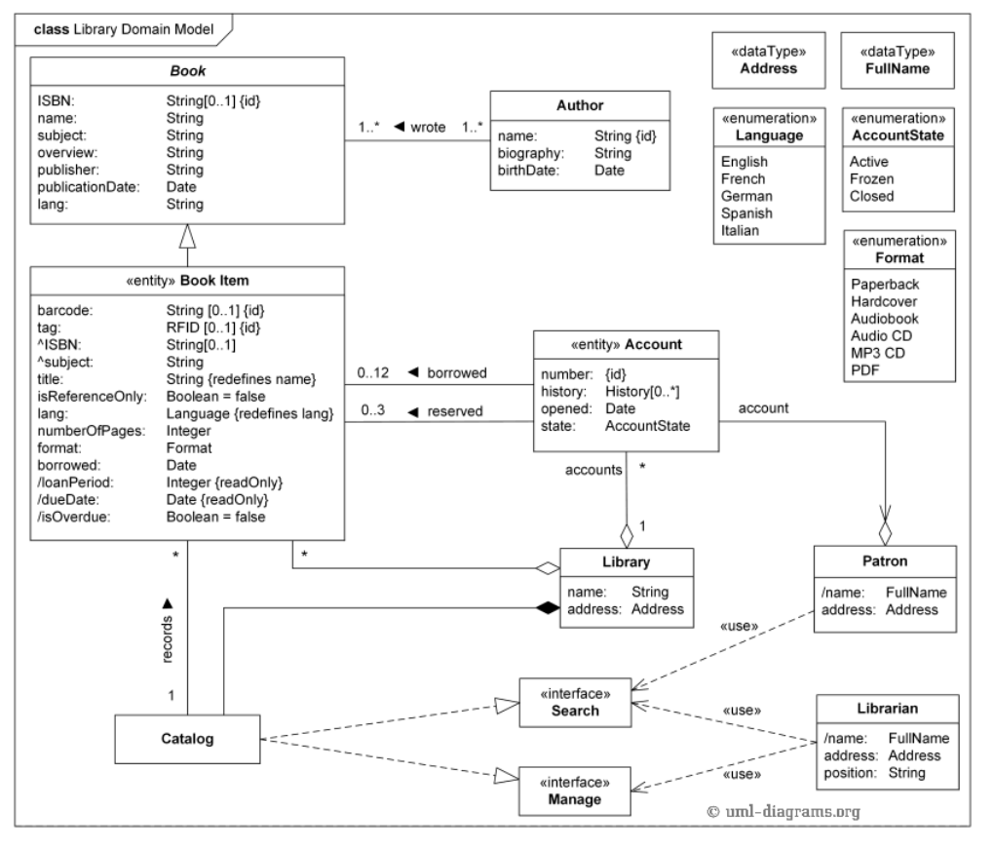

Slide 20
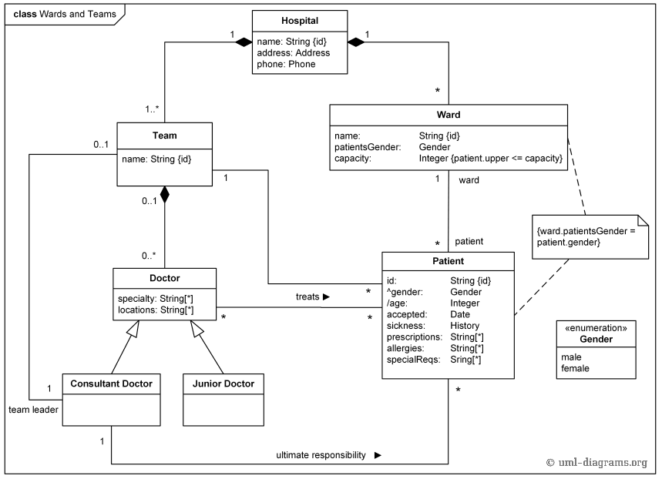

Slide 21
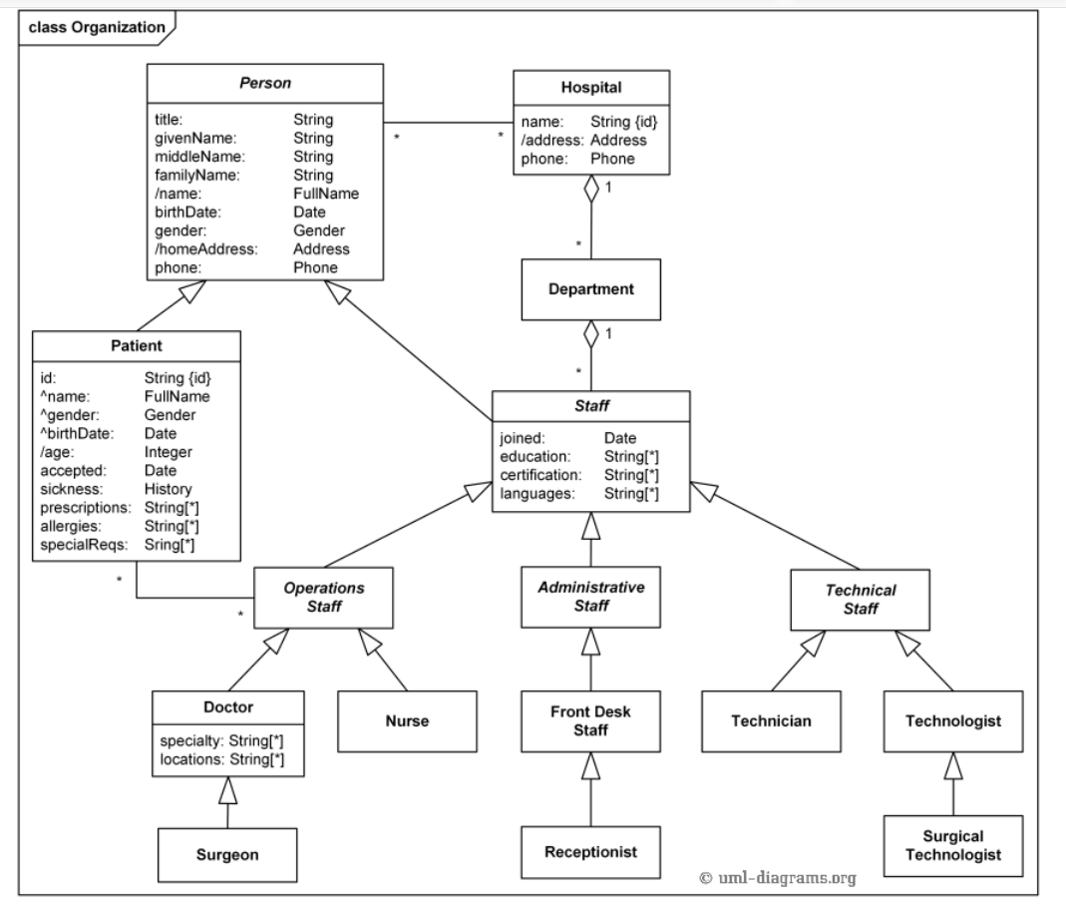

Slide 22
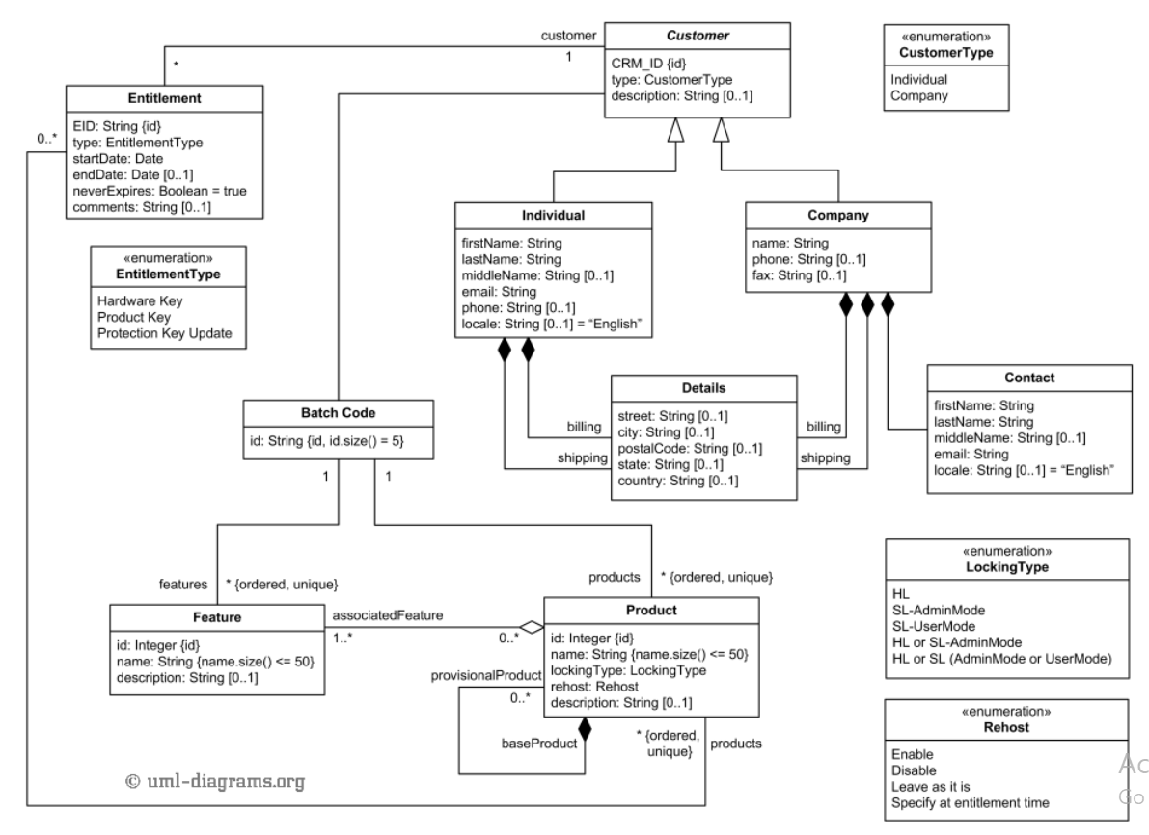

Slide 23
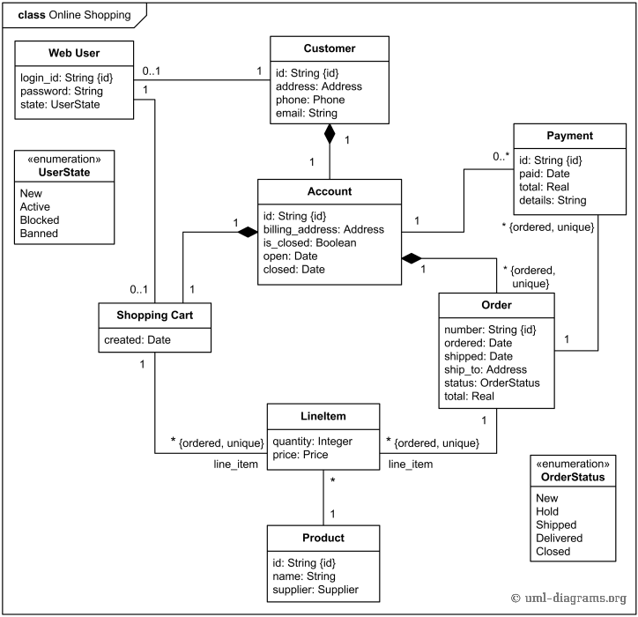

Slide 24
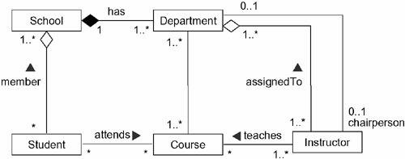

Slide 25
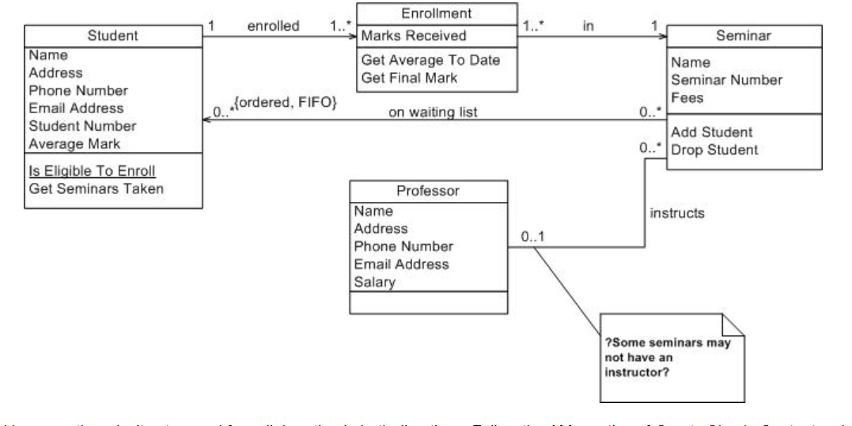

Slide 26
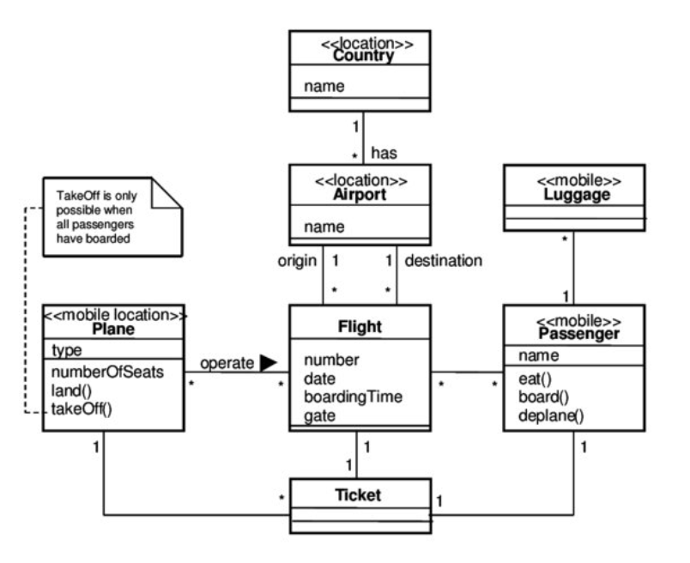

Slide 27
